Slide 1
Parking SENSOR USING ARDUINO
ATTA JIROFTY – NIMA SOHEILI RAD – MOSTAFA KHAKI – AMIRHOSSEIN SHARIFI
FALL 1398
Dr. Sadr-o-Saddat
Yazd University

Slide 2
Introduction
Implementing parking sensor with Arduino Uno.
Using Ultrasonic sensor, Piezo Buzzer, LEDs, 12v fan, Transistor & Resistors.
Emphasizing that we can turn on another device ( e.g. a fan in this project ) when a collision is going to happen.
Economically efficient rather than buying a parking sensor.
Implementing blinking methods for LEDs, using delays & interrupts.

Slide 3
Introducing Arduino
Open source hardware.
Consist of an Atmel 8-bit AVR microcontroller (ATmega8, ATmega168, ATmega328, ATmega1280, ATmega2560 )
Single or double-row pins or female headers that facilitate connections for programming and incorporation into other circuits.
Supports add-on modules named SHEILDS ( addressable via I2C serial bus ).
Includes a 5V linear regulator & a 16MHz crystal oscillator.
Pre-programmed with a boot loader that simplifies uploading of programs to the on-chip flash memory ( default optiboot bootloader ).
Uno provide 14 digital I/O pins, 6 of which can produce pulse-width modulated signals, and 6 analog inputs, which can also be used as six digital I/O pins.

Slide 4
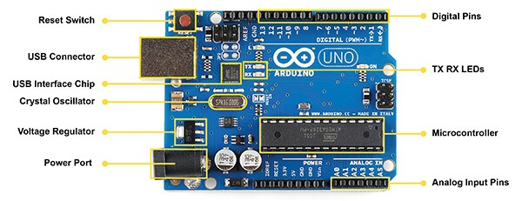
Arduino ports & Pins

Slide 5
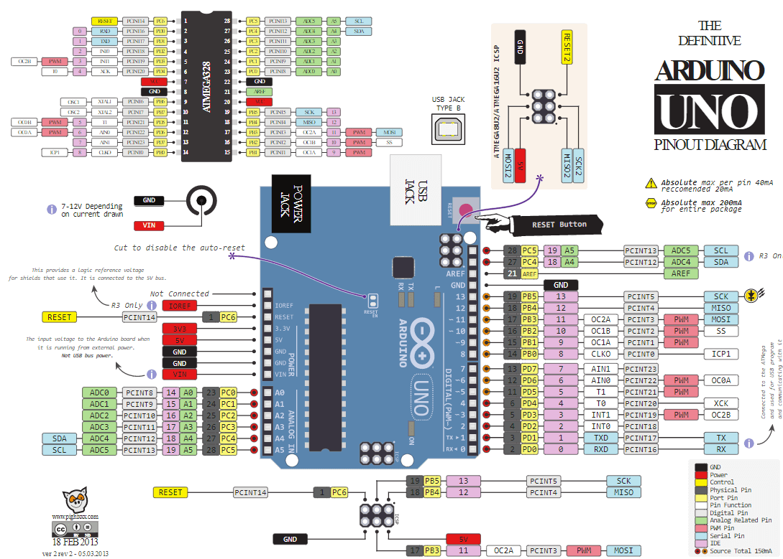
Arduino ports & pins

Slide 6
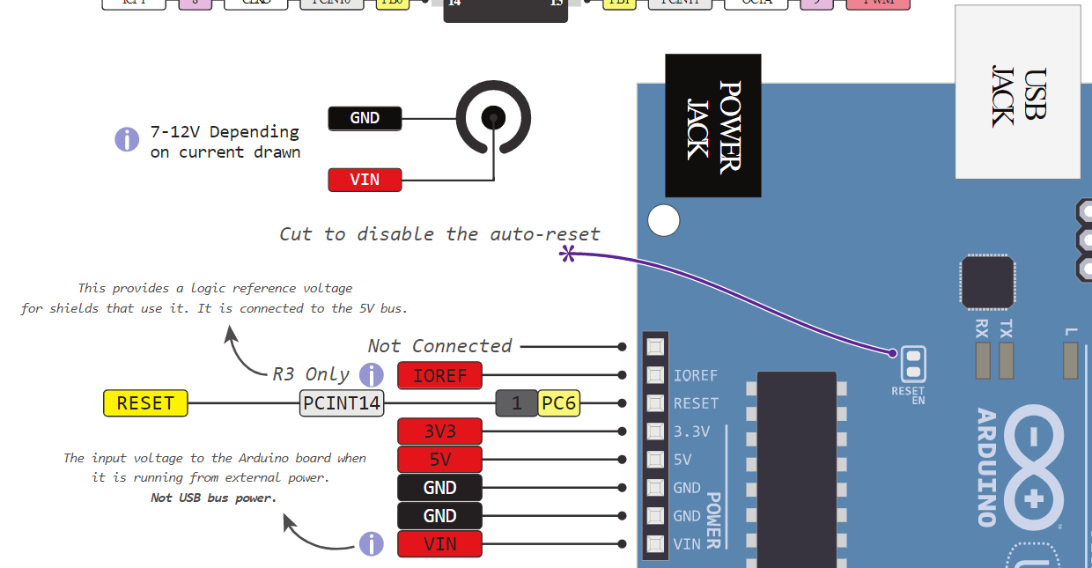
1. Arduino Uno pinout - Power Supply

Slide 7
1. Arduino Uno pinout - Power Supply
5v and 3.3v :
They provide regulated 5 and 3.3v to power external components according to manufacturer specifications.
GND :
In the Arduino Uno pinout, you can find 5 GND pins, which are all interconnected.
The GND pins are used to close the electrical circuit and provide a common logic reference level throughout your circuit.
RESET : resets the Arduino
IOREF : This pin is the input/output reference. It provides the voltage reference with which the microcontroller operates.

Slide 8
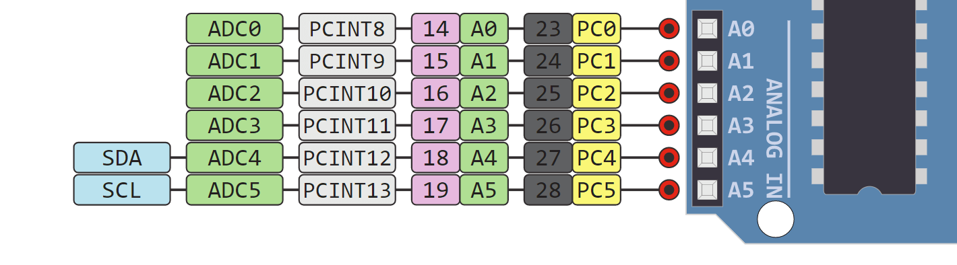
2. Arduino Uno Pinout - Analog IN

Slide 9
2. Arduino Uno Pinout - Analog IN
The Arduino Uno has 6 analog pins, which utilize ADC (Analog to Digital converter).
These pins serve as analog inputs but can also function as digital inputs or digital outputs.
Capable of reading analog voltages.
ADC has 10-bit resolution, meaning it can represent analog voltage by 1,024 digital levels. The ADC converts voltage into bits which the microprocessor can understand.

Slide 10
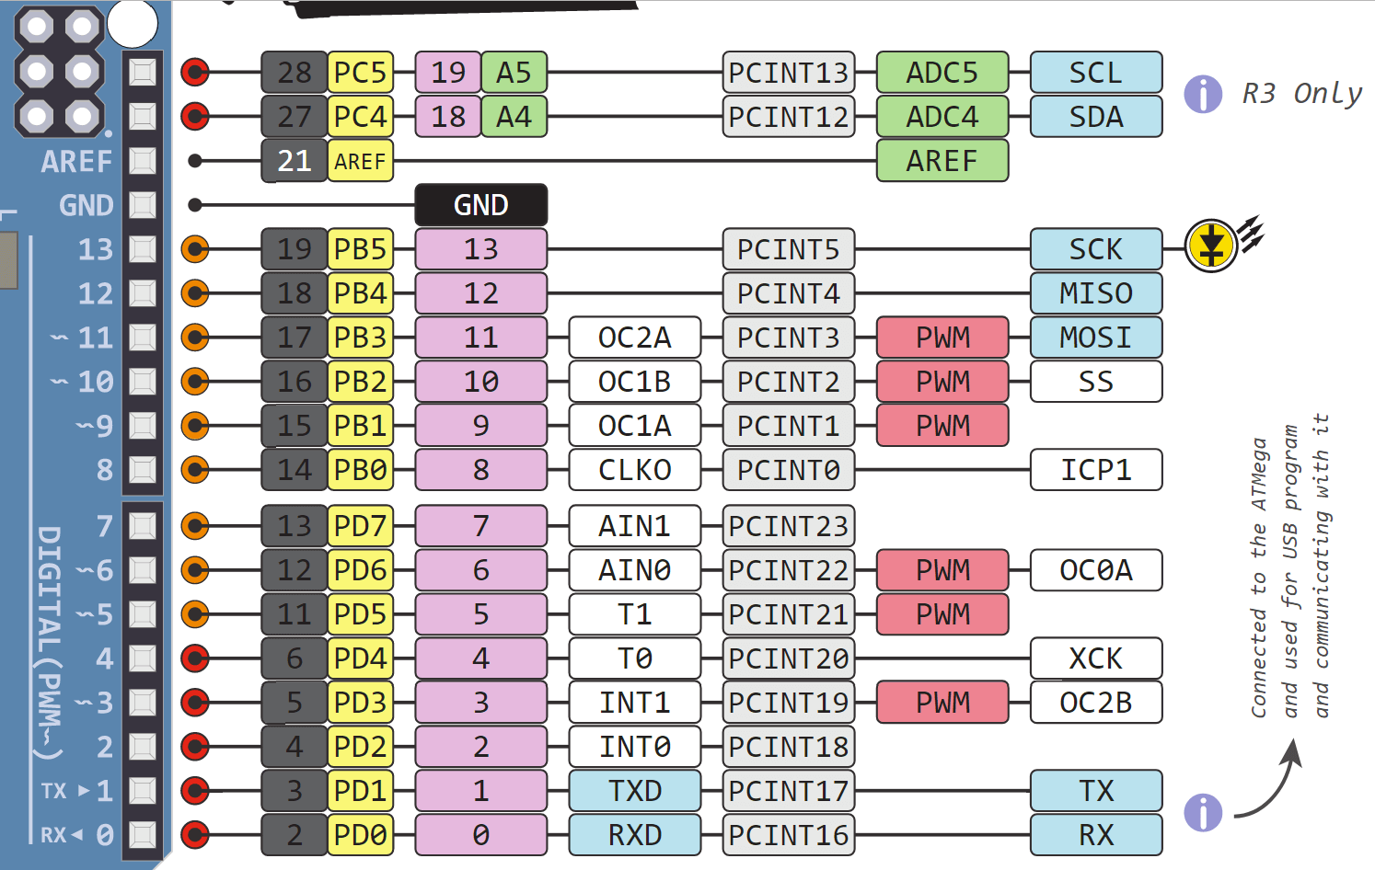
3. Arduino Uno Pinout - Digital Pins

Slide 11
3. Arduino Uno Pinout - Digital Pins
Pins 0-13 of the Arduino Uno serve as digital input/output pins.
Pin 13 of the Arduino Uno is connected to the built-in LED.
In the Arduino Uno - pins 3,5,6,9,10,11 have PWM capability ( ~ sign ).
It’s important to note that:
Each pin can provide/sink up to 40 mA max. But the recommended current is 20 mA.
The absolute max current provided (or sank) from all pins together is 200mA

Slide 12
3. Arduino Uno Pinout - Digital Pins
What is PWM?
In general, Pulse Width Modulation (PWM) is a modulation technique used to encode a message into a pulsing signal. A PWM is comprised of two key components: frequency and duty cycle. The PWM frequency dictates how long it takes to complete a single cycle (period) and how quickly the signal fluctuates from high to low. The duty cycle determines how long a signal stays high out of the total period. Duty cycle is represented in percentage.
In Arduino, the PWM enabled pins produce a constant frequency of ~ 500Hz, while the duty cycle changes according to the parameters set by the user.

Slide 13
3. Arduino Uno Pinout - Digital Pins
Communication Protocols :
Serial (TTL) - Digital pins 0 and 1 are the serial pins of the Arduino Uno.
They are used by the onboard USB module.
SPI - SS/SCK/MISO/MOSI pins are the dedicated pins for SPI communication. They can be found on digital pins 10-13 of the Arduino Uno and on the ICSP headers.
I2C - SCL/SDA pins are the dedicated pins for I2C communication. On the Arduino Uno they are found on Analog pins A4 and A5.

Slide 14
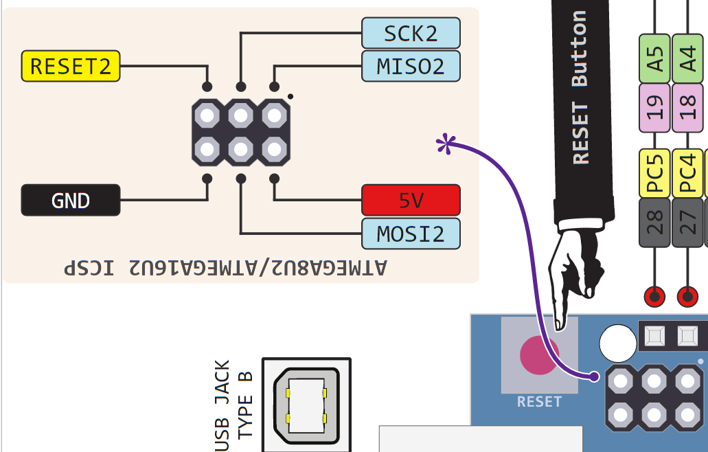
4. Arduino Uno Pinout - ICSP Header

Slide 15
4. Arduino Uno Pinout - ICSP Header
ICSP stands for In-Circuit Serial Programming. The name originated from In-System Programming headers (ISP).
Manufacturers like Atmel who work with Arduino have developed their own ICSP headers. These pins enable the user to program the Arduino boards’ firmware. There are 6 ICSP pins available on the Arduino board that can be hooked to a programmer device via a programming cable.
Source

Slide 16
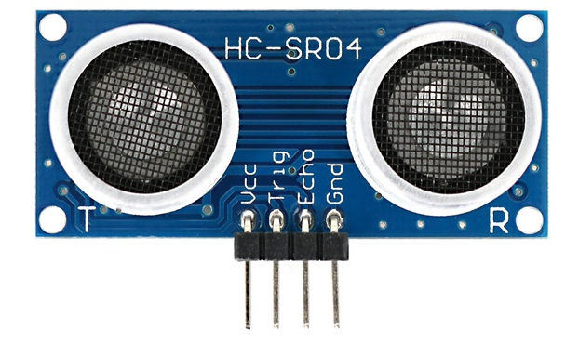
Introducing ultra sonic

Slide 17
Introducing ultra sonic
History behind it : 1912 after Titanic sinking – Mr. L F Richartson
Measures the distance to an object using ultrasonic sound waves.
An ultrasonic sensor uses a transducer to send and receive ultrasonic pulses that relay back information about an object’s proximity.
High-frequency sound waves reflect from boundaries to produce distinct echo patterns.
Works by sending out a sound wave at a frequency above the range of human hearing.
Uses a single transducer ( TRANSFORMER ) to send a pulse and to receive the echo.
Measuring time lapses between the sending and receiving of the ultrasonic pulse.
Independent of Light,Smoke,Dust,Color

Slide 18
How ultrasonic sensor works
Distance= (Time x Speed of Sound in Air (340 ms))/2

Slide 19
How ultrasonic sensor works
1. High level signal is sent for 10µs using Trigger.
2. The module sends eight 40 KHz signals automatically, and then detects whether pulse is received or not.
3. If the signal is received, then it is through high level. The time of high duration is the time gap between sending and receiving the signal.
Source

Slide 20
Ultrasonic specifications
Supply voltage | 5 v
Global Current Consumption | 15 mA
Ultrasonic frequency | 40k Hz
Max range | 400 cm
Min range | 3 cm
Resolution | 1 cm
Trigger Pulse Width | 10 µs
Outline Dimension | 43x20x15 mm
Source

Slide 21
Light-emitting diode – LED
We use 3 LEDs
Green : safe distance – Yellow : warning – Red : danger zone !!
Need resistors : Arduino runs at 5V. But not all that will go over the resistor. The LED also has a voltage drop, typically around 2V. So there remains 3V for the resistor. A typical indicator LED will have a nominal current of 20mA, then :
R=5V−2V/20mA=150Ω
The Atmega328 datasheet says that the current for any I/O pin shouldn't exceed 40mA. Since you don't have anything to limit the current there's only the (low!) resistance of the output transistor. The current may so well be higher than 40mA, and your microcontroller will suffer damage.
Source

Slide 22
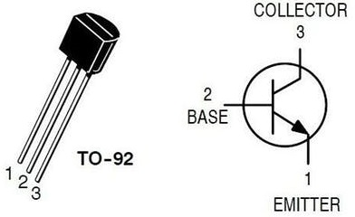
12v Fan using a 2n3904 BJ331 transistor
Connecting Emitter to GND pin – Connecting Base to pin 11 – connecting Collector to fan
Controlling fan using a transistor. Without transistor fan will always spin!
If Base == LOW ( 0 ) then fan turns off
Source

Slide 23
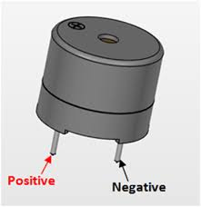
Piezo Buzzer
Rated Voltage: 6V DC.
Operating Voltage: 4-8V DC.
Rated current: <30mA.
Sound Type: Continuous Beep.
Resonant Frequency: ~2300 Hz.
Small and neat sealed package.
Breadboard and Perf board friendly.

Slide 24
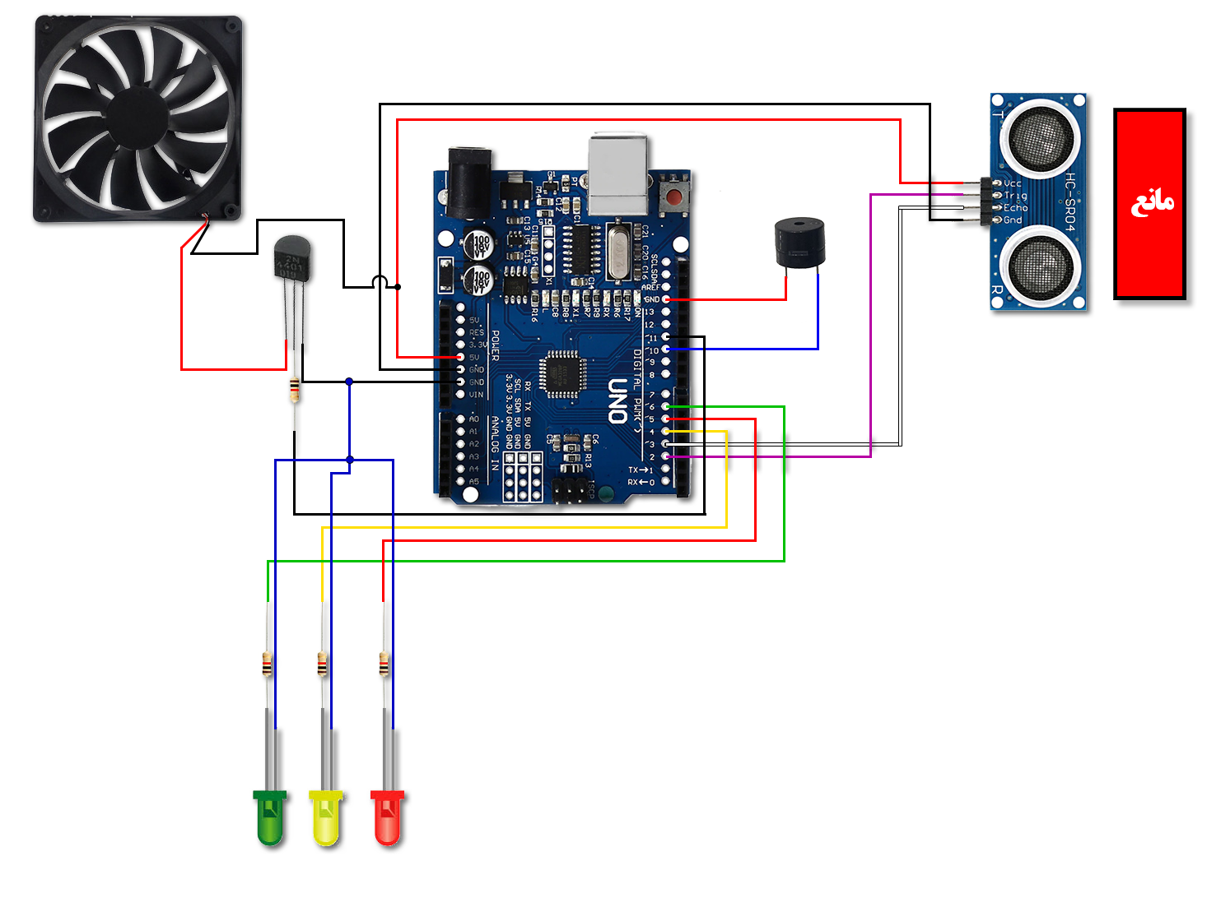
Board architecture & implementation

Slide 25
Conclusion
Can be produced in large quantities for automobile companies.
Economically efficient
can be a national production.
It’s fun
You can even produce it in your home for your own car or something
Not only for cars. Use it for your home security or your room door or any door
Can notify you on your phone or via email using IOT technology & Wi-Fi module or nodeMCUs ( not implemented in this project though ! )

Slide 26
Sources
1. https://create.arduino.cc/projecthub
2. https://electronics.stackexchange.com
3. https://www.robotshop.com
4. https://circuitdigest.com/microcontroller-projects
5. https://www.circuito.io/blog/arduino-uno-pinout

Slide 27
THE END
“Thank You”

